Slide 1
A Comprehensive Analysis of Global Financial Metrics
Group 1
- Manoj Padala
- Moustapha Cisse
- Yasaswitha Gaddam

Slide 2
Introduction
TBD

Slide 3
Question1 :

Slide 4
Question 2: How the fluctuations in the prices of Gold, Silver, Natural Gas and Crude Oil in the global markets have affected the performance of the US Dollar over the last 15 years?
Moustapha Cisse

Slide 5
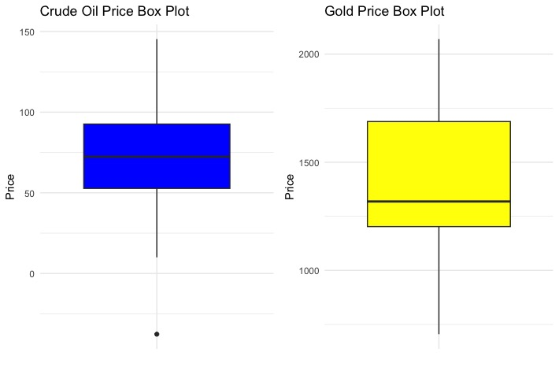
Boxplots
Crude oil:
- one or few outliers
Gold Index

Slide 6
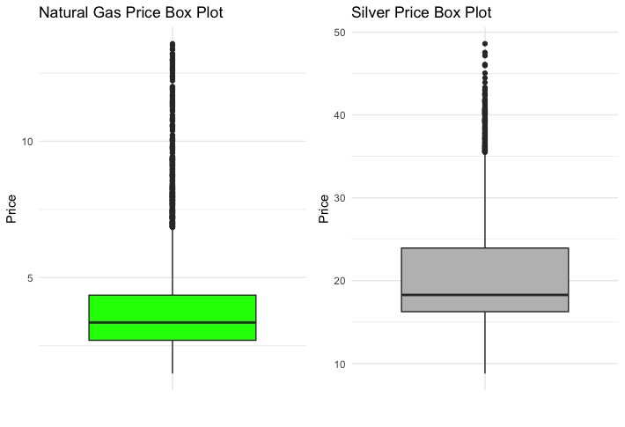
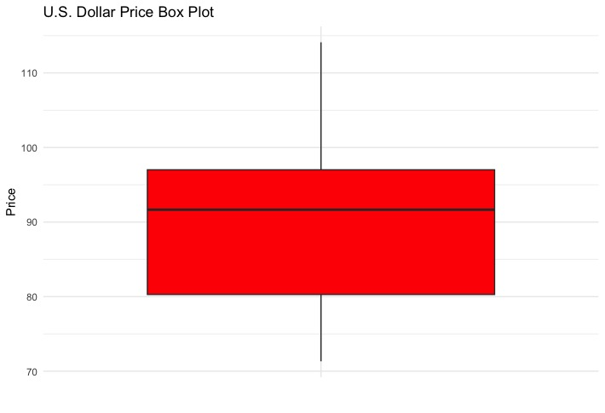
Outliers:
- Natural Gas Index
- Silver Index
U.S. Dollar Index
- no outliers

Slide 7
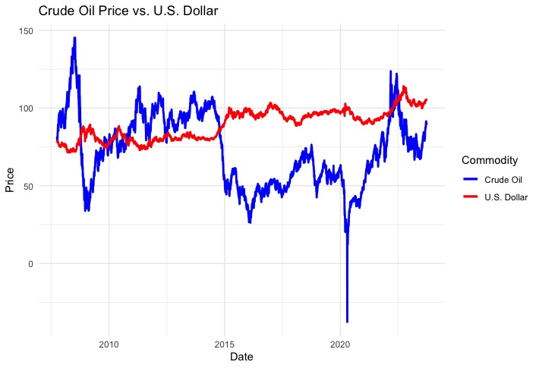
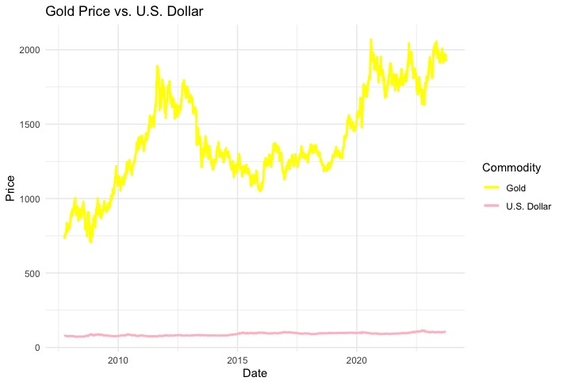
Line plots
Crude oil Index & U.S. Dollar index (inverse)
Corr coef =
Gold Index & U.S. Dollar index (none changes)
Corr coef=

Slide 8
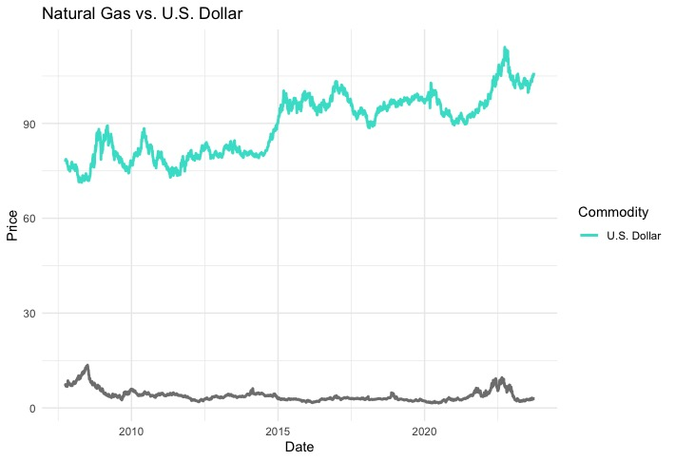
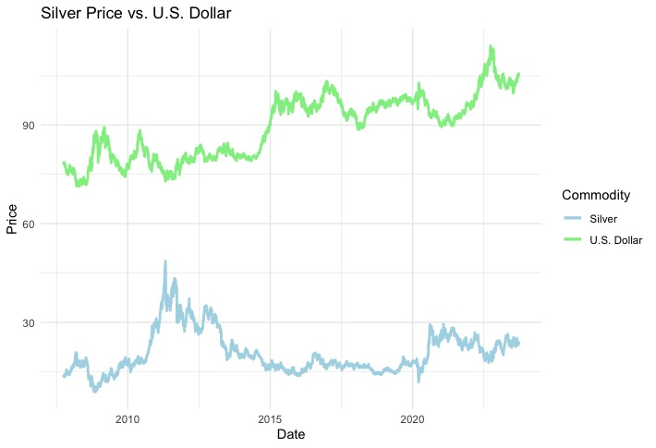
Silver Index & U.S. Dollar Index (negative)
Corr coef =
Natural Gas Index & U.S. Dollar Index (inverse)
Corr Coef =

